Slide 1
Algorithms for edge detection: Review
Algorithm 1:
Compute gradients
Compute magnitude
Threshold magnitude
Smoothing, followed by Algorithm 1
ie, the Sobel edge detector
The association property of convolutions

Slide 2
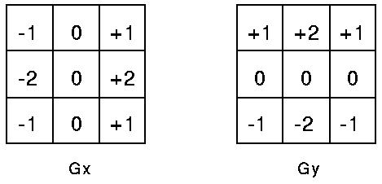

Sobel edge detector: Review
First these two masks are applied to the image.
The magnitude of the gradient is then calculated
using the formula which we have seen before:
Then, the two output tables of the masks and image are combined using the magnitude formula. This gives us a smoothened gradient magnitude output.

Slide 3
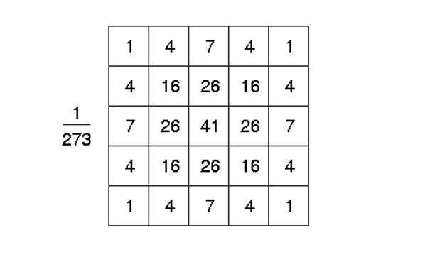
Canny edge detector, Part 1: Review
We can use either a table of weights, or we can use an equation within the code to
Increase accuracy.

Slide 4
Canny Algorithm, Part One: Programming
So, the main difference between Canny Part One and Sobel is
the smoothener (Canny uses a Gaussian Sobel uses the four one’s.
To write code for canny, we will start with marrh.c and do these steps.
-- Marrh.c uses flexible size masks (which we need), we will keep
this part of the code.
-- Marrh.c uses second derivatives, whereas we need only first derivatives
(we need first x- and y- derivatives), so we will change the equation
in the marrh.c line to be the first x-derivative.
-- Then, because we need two derivatives, we will double up on that line,
i.e., make a copy of it to compute the y-derivative, finally ending
up with two masks (xmask and ymask).

Slide 5
Canny Algorithm, Part One
-- Then use the convolution code from marrh but remember to double up on it, to get two outputs.
-- Then delete the code in marrh that is below the convolution code.
-- Then bring in the sqrt (of squares) code from sobel. This will compute the
magnitude, will scale it for output, and will print it out.
-- At this point, you are done with Canny part One, and your code should
produce output very similar to the Sobel magnitude image.

Slide 6
Canny Part Two
Normally called Non-maximaSuppression
We will call it RidgePeaks of Magnitude Image

Slide 7
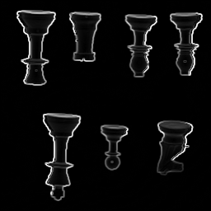
Canny Part Two
Consider the Magnitude image obtained in Part One
Think about it as a terrain map.
So, its numbers represent height.

Slide 8
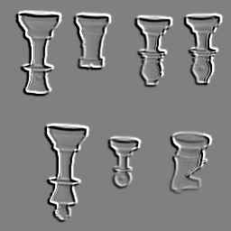
Canny Part Two
The Magnitude image can be viewed as a relief map (on right)
Let us examine a ridge in this relief map (the magnitude pic)

Slide 9
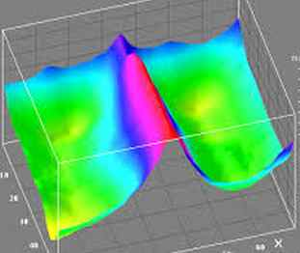
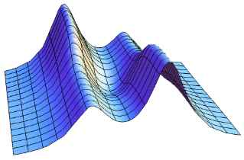
Canny Part Two
Visualize ridges in this relief map (the magnitude image). Two different ways to visualize are shown here.
Figure is from internet
Figure is from internet
Ridges in the magnitude image represent edges.
The stronger the brightness jump in the original
picture, the higher the ridge in the magnitude image.

Slide 10
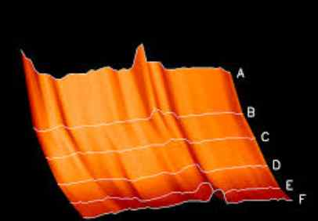
Canny Part Two
Consider some ridges, and how to find their peaks.
For the ridges shown, we would want to traverse a row, such as, say, B, C, D, or E, and ask if we are finding a peak as we encounter the values in that row. A Peak is simply a position
whose magnitude value exceeds that of the neighbor to the left and to the right. This is MaxTest.
Figure is from internet

Slide 11
Canny Part Two
Direction for MaxTest:
MaxTest runs across these rows. If we knew that the ridge is a vertical one (as these examples are), we would NOT want to run MaxTest in a vertical direction or in a diagonal direction (for these specific ridges). i.e., MaxTest runs in a direction perpendicular to the ridge.
Figure is from internet

Slide 12
Canny Part Two
MaxTest’s Direction: Hmmm… Perpendicular to the ridge??
MaxTest runs in a direction perpendicular to the ridge.
Well, that is simply IN THE DIRECTION OF THE GRADIENT!
Figure is from internet
The gradient was a vector. We used its Magnitude. Now we get to employ its Direction.

Slide 13
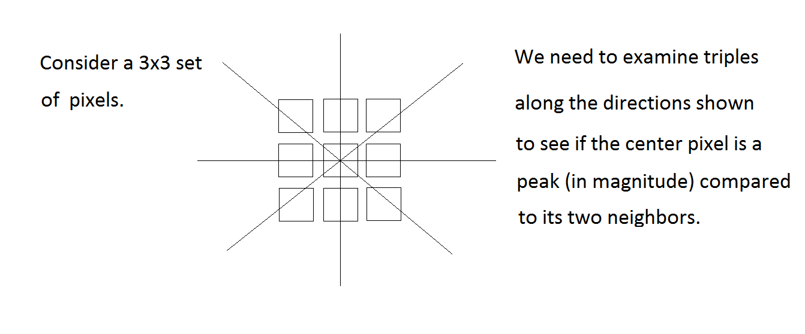
Canny Part Two

Slide 14
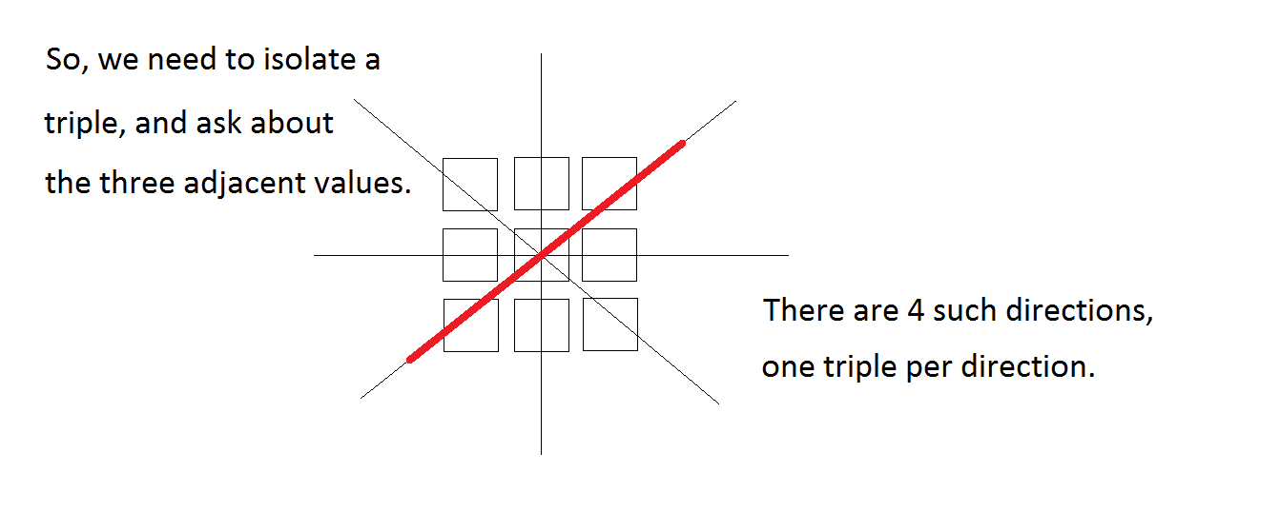
Canny Part Two

Slide 15
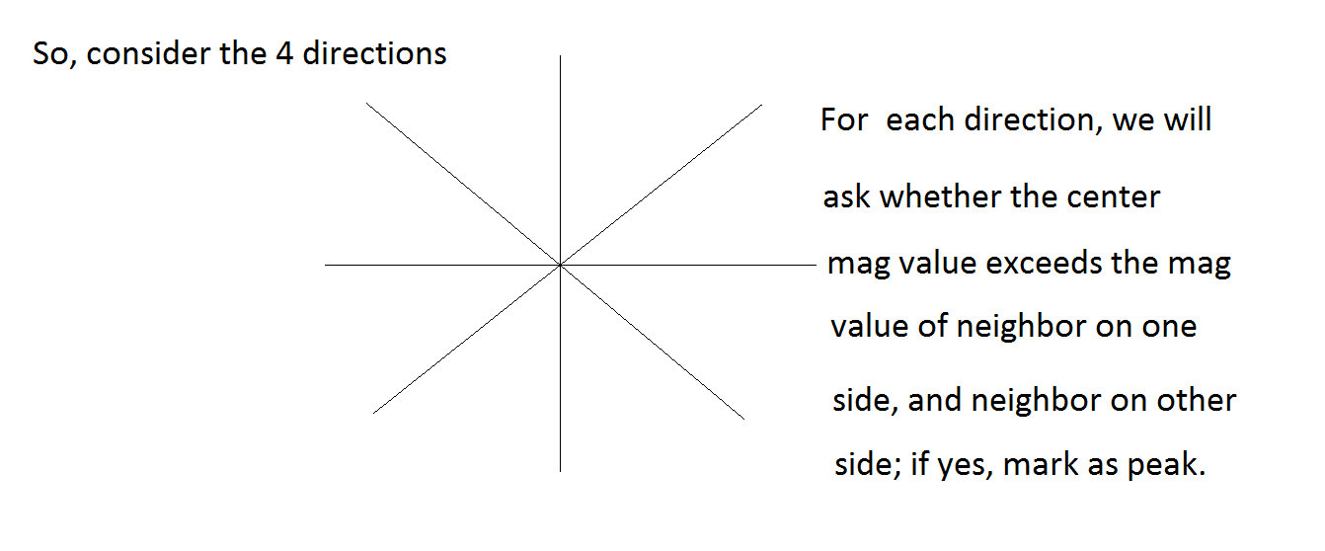
Canny Part Two

Slide 16
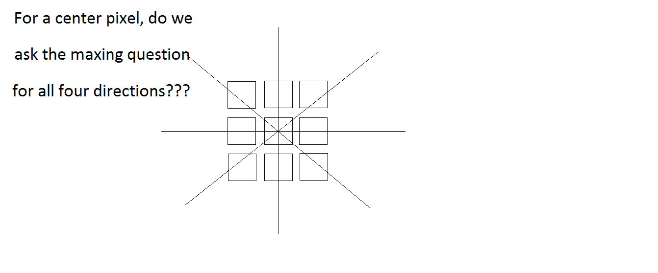
Canny Part Two

Slide 17
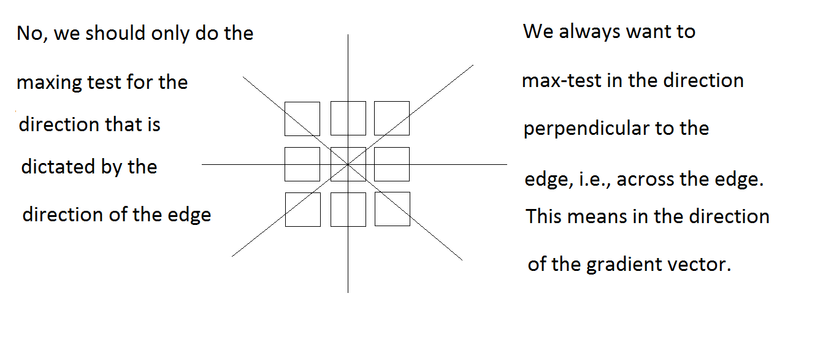
Canny Part Two

Slide 18
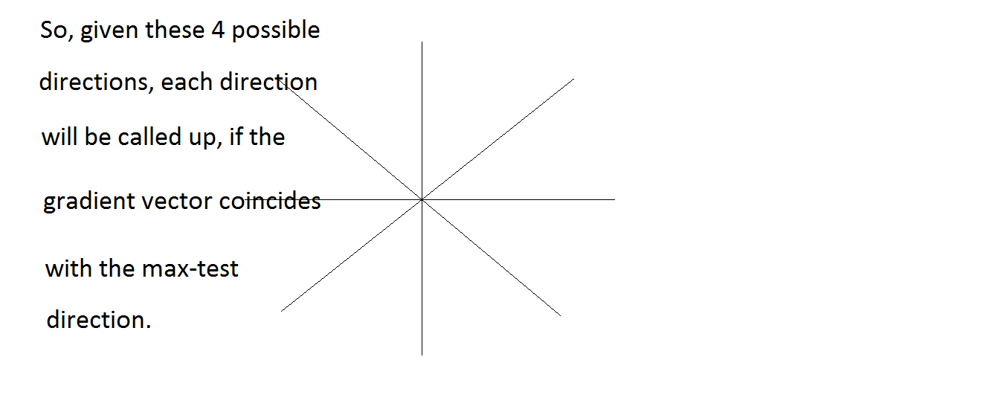
Canny Part Two

Slide 19
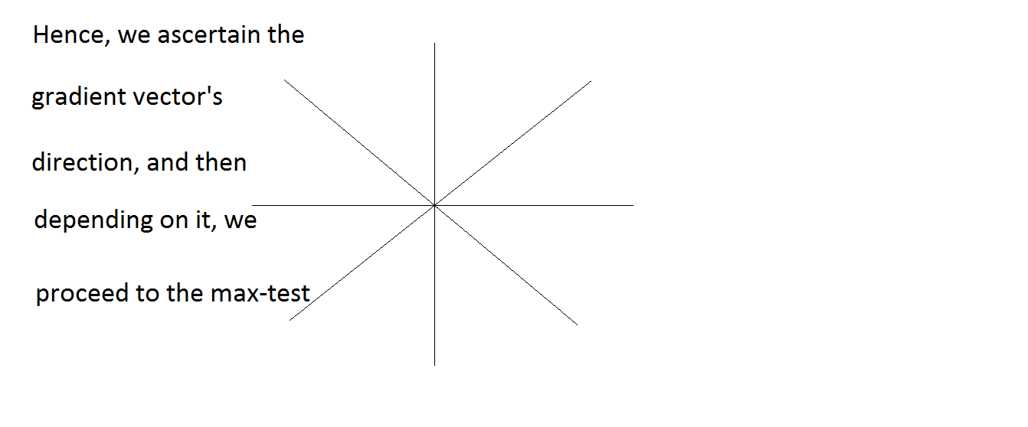
Canny Part Two

Slide 20
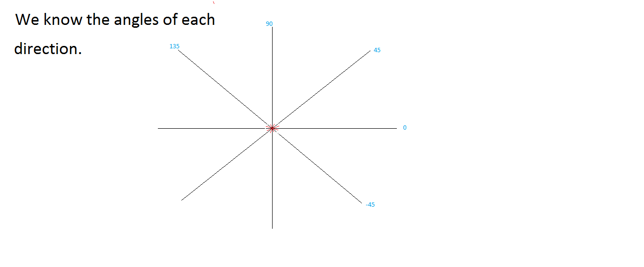
Canny Part Two

Slide 21
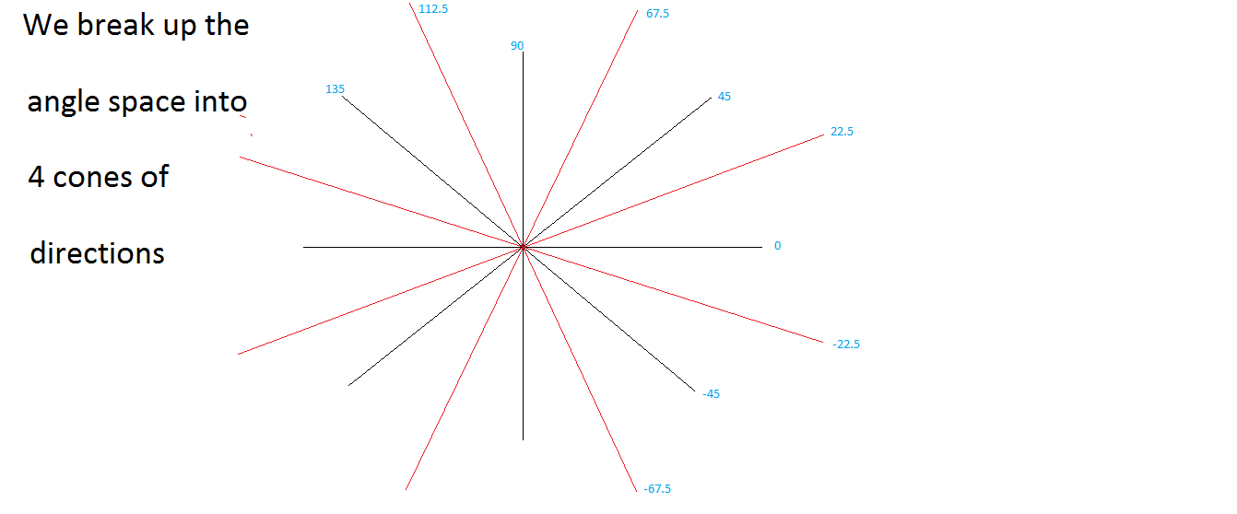
Canny Part Two

Slide 22
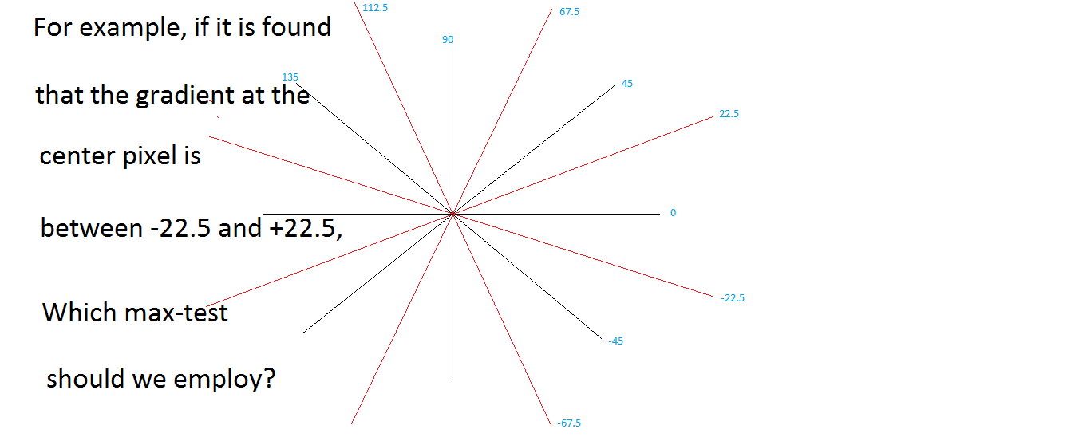
Canny Part Two

Slide 23
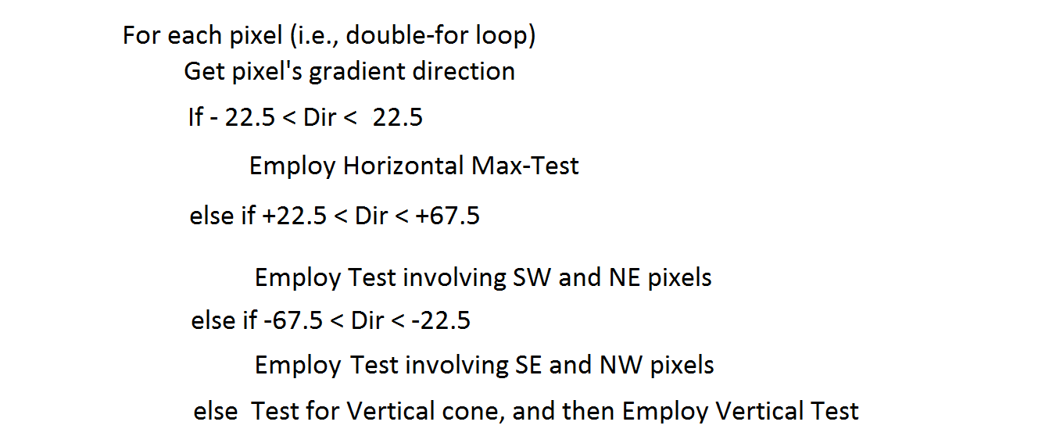
Canny Part Two

Slide 24
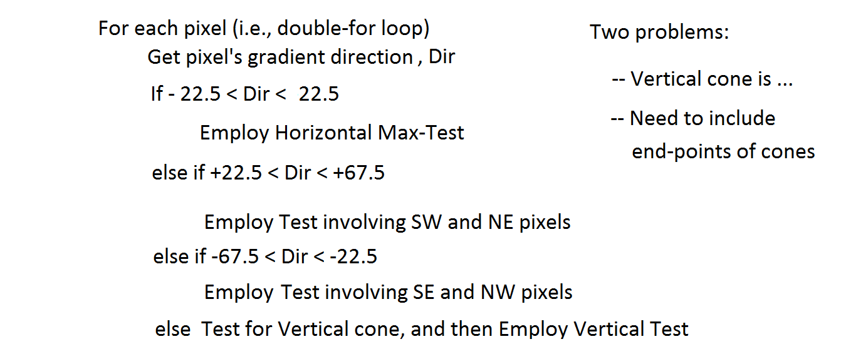
Canny Part Two

Slide 25
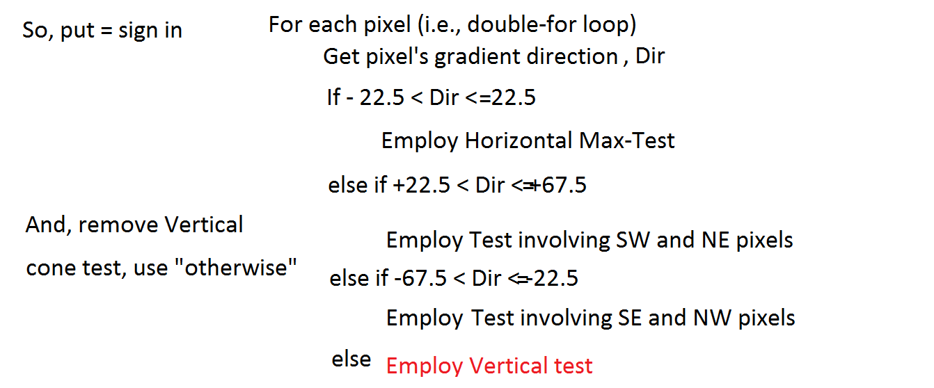
Canny Part Two

Slide 26
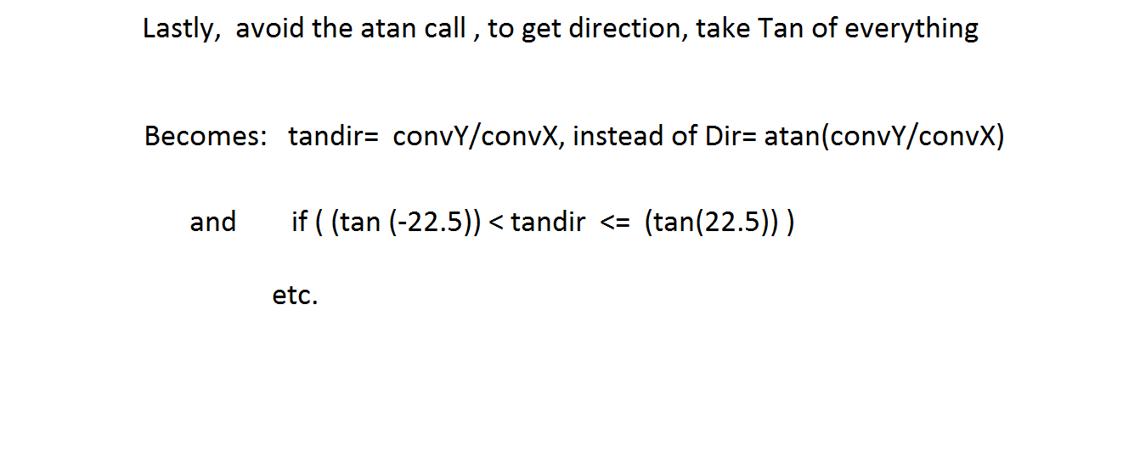
Canny Part Two

Slide 27
Actual code for Peaks
for(i=MR;i<256-MR;i++){
for(j=MR;j<256-MR;j++){
if((xconv[i][j]) == 0.0) {
xconv[i][j] = .00001;
}
slope = yconv[i][j]/xconv[i][j];
if( (slope <= .4142)&&(slope > -.4142)){
if((mag[i][j] > mag[i][j-1])&&(mag[i][j] > mag[i][j+1])){
cand[i][j] = 255;
}
}
else if( (slope <= 2.4142)&&(slope > .4142)){
if((mag[i][j] > mag[i-1][j-1])&&(mag[i][j] > mag[i+1][j+1])){
cand[i][j] = 255;
}
}
else if( (slope <= -.4142)&&(slope > -2.4142)){
if((mag[i][j] > mag[i+1][j-1])&&(mag[i][j] > mag[i-1][j+1])){
cand[i][j] = 255;
}
}else{
if((mag[i][j] > mag[i-1][j])&&(mag[i][j] > mag[i+1][j])){
cand[i][j] = 255;
}
}
}
}

Slide 28
Hysteresis (Double) Threshold

